Slide 1
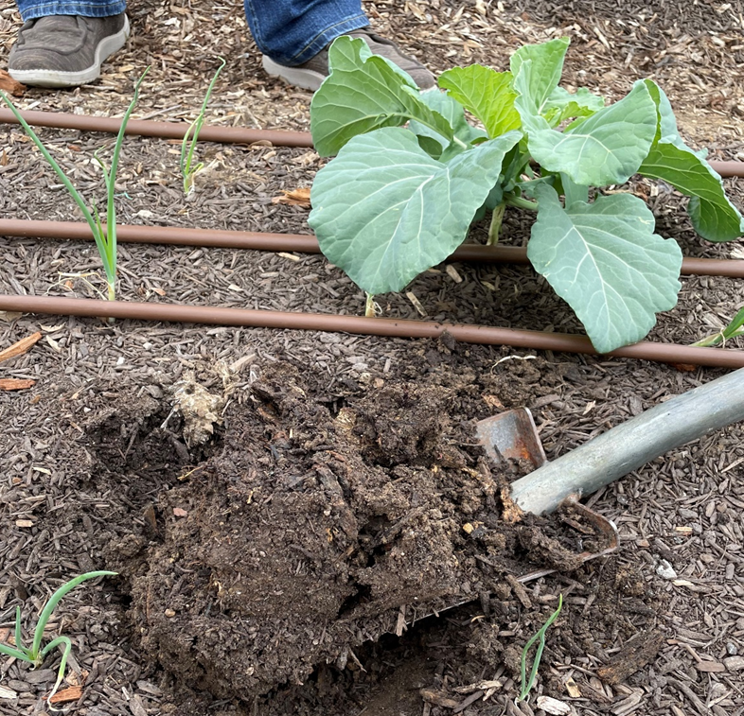
MODULE 4:
Site evaluation and
soil contamination
Notes:
Soil contamination, and questions about how to assess the potential for soil contamination, are topics that regularly come up in discussions of small-scale agriculture, particularly urban agriculture.
In this module we will summarize background information that is key to understanding the topic of soil contamination. We will focus on contamination with heavy metals, and lead (Pb) in particular, because good information exists related to lead and soil health. We will also look at a larger process of site evaluation to identify the potential risks of contamination and at some technical methods for screening and testing soils for heavy metals.
While contamination is a complex topic that often requires expert advice, we hope that this module will help you all to feel more comfortable discussing the topic.
Photo: Josh Beniston, USDA NRCS. Assessing soil health in the field at an urban farm in Fort Worth TX.

Slide 2
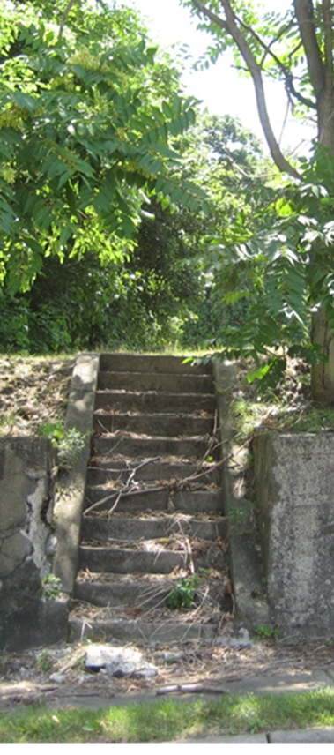
Objectives
Evaluate soil conditions at urban sites using both background research and field assessment.
Summarize basic considerations for understanding soil contamination and its assessment.
Utilize online tools to conduct research on the management history and the potential risk for contamination risk at these sites.
Discuss the appropriate use of field assessments of soil physical and biological properties at urban sites, using NRCS protocols.
Notes:
Go through specific objectives for the module.
Photo: Josh Beniston, USDA NRCS. Stairs at an empty urban lot where a vacant residential home had previously been demolished in Youngstown, OH.

Slide 3
Intro Questions
Is the process for evaluating site conditions different for urban sites vs rural sites?
What is different about it?
How does the potential for soil contamination change the way that we evaluate urban sites for conservation planning?
Notes:
Go through discussion questions one by one and take a few responses for each question.

Slide 4
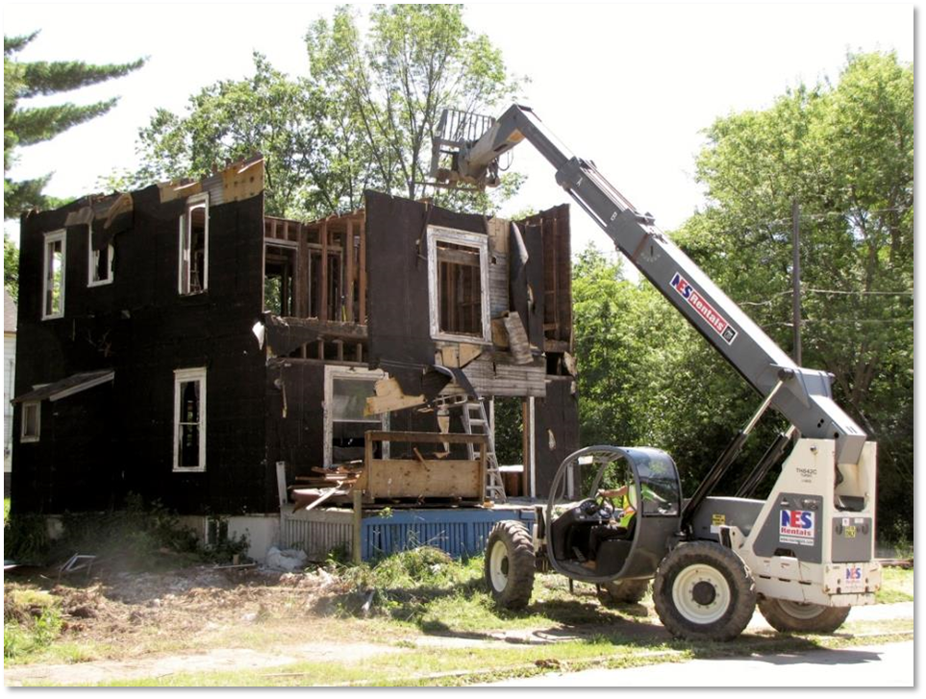
Soil Contamination
How would you define “soil contamination”? What is it?
Photo: Youngstown Neighborhood Development Corporation, OH.
Notes:
Ask group how they would define soil contamination.
Photo: Youngstown Neighborhood Development Corporation, Youngstown OH. Shows the process of a vacant residential home being demolished. This is a common practices in many cities with declining populations. Often cities hope to establish green spaces and even gardens on lots after vacant structures have been demolished.

Slide 5
Soil Contamination
Elevated concentrations of elements and compounds that are hazardous to human health
Heavy metals (Pb, As, Cd, etc.)
Organic compounds (petrochemicals, PAHs, PFAS)
Land use guidelines based on soil screening levels from U.S. EPA and state level agencies.
Photo: Youngstown Neighborhood Development Corporation, OH.
Notes:
Key to the definition of contamination is the first bullet point here. Contamination is elevated concentrations of hazardous elements and compounds. These elements may occur naturally, but the elevated concentrations present a risk to human health.
Heavy metals are the contaminant affecting soils that we know the most about. Lead (Pb) in soils has been studied in many urban areas and is the most common contaminant of concern because of the risks of lead poisoning in people. We have good guidance on lead contamination in soils and less so for the other heavy metals.
There are also many organic chemicals that can be soil contaminants. This includes basic petrochemicals such as diesel fuel, agricultural chemicals, and polycyclic aromatic hydrocarbons (PAHs) which are widespread hazardous compounds that come from incomplete combustion of materials. PFAS, or per- and polyfluoroalkyl substances, are a contaminant of current interest as there have been cases of serious contamination by PFAS on farms and agricultural soils. PFAS are widespread in the environment and do not break down easily. There is an increasing amount of information available about PFAS contamination.
In general, there is not a lot of easily accessible information about soil contamination by organic compounds. There are also not many laboratories that offer testing of organic compounds in soils. The testing that is available is generally hundreds of dollars per sample. So assessing and managing organic compounds in soils remains challenging.
USEPA maintains and publishes guidance on what levels of individual contaminants are considered a risk. Most guidance on managing soils to reduce risk of health impacts from contaminants is based on USEPA guidance. However, it is very important to note that many states have environmental departments that issue state specific guidance on soil contaminants. NRCS planners and state technical staff are advised to determine if their state has state level guidance and to defer to state guidance.

Slide 6
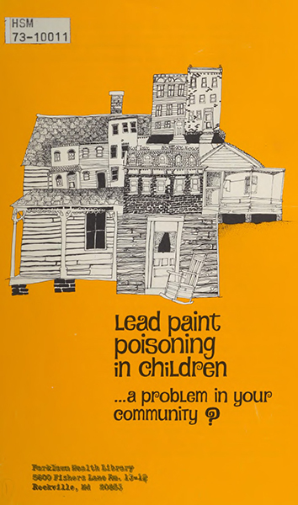
How Does Soil Contamination Occur?
Past (or present) industrial land uses on site or in vicinity.
Use of chemical products on or near site.
  Lead paint and leaded gasoline
  Petroleum spills and dumping
  Pesticides
  Others…
Airborne deposition of contaminant particulate matter
Notes:
The majority of soil contamination is a legacy of past land uses on the site or in the near vicinity that resulted in the deposition or dumping of hazardous compounds in the soil. Those compounds are then held in the soil and the contaminated soil becomes a reservoir of these hazardous materials.
This may occur from a history of heavy industry, such as manufacturing, or from smaller business such as laundromats that have a history of using hazardous materials.
In the case of lead (Pb), contamination has occurred from the historical use of products that contained lead, such as lead paint and leaded gasoline.
Hazardous petroleum products can end up in soil at sites with a history of use as fueling stations, garages, or areas where people dumped waste. Soil can be contaminated by past use of pesticides that contained heavy metals, such as the use of lead arsenate historically in orchards.
While historical land use is the big driver of soil contamination, there is also research that has documented continued airborne deposition of contaminates in soil. This can occur in areas where industrial manufacturing still occurs, or in areas where soil contamination is widespread enough to generate dust and airborne deposition of soil particles.
Photo: Josh Beniston, USDA NRCS. Historical pamphlet on the risk of lead poisoning from lead paint.

Slide 7
Question
How do people get exposed to soil contaminants?
What are the “exposure pathways”?
Notes:
Ask participants if they are aware how people are exposed to contaminated soil and take a few responses. How does exposure occur?

Slide 8

Contaminant Exposure Pathways
Direct ingestion of soil
  Dust inhalation
  Skin exposure
  Dust and skin exposure from soil on clothing.
  Children eating soil
  Eating produce where soil hasn’t been fully washed off
Uptake by crop plants
Notes:
Following on the question from the previous slide.
The majority of human exposure to contaminated soil comes from direct ingestion of the soil itself. Soil ingestion can occur through dust inhalation or ingestion, as well as by ingestion of soil. Small children are considered a high risk because they are closer to the ground and because children can easily eat soil in the course of playing in an area.
Crop plants can take up some heavy metals and contaminants, particularly in soils with high concentrations, but uptake by crops is not considered to be as significant a risk as ingestion of soil. It is also critical that vegetables grown at sites with some risk of contamination are thoroughly washed, as ingestion of soil can occur via soil particles on the crops themselves.
Photo: Josh Beniston, USDA NRCS – A young child holding a carrot that was just harvested in a backyard garden. The carrot still has a significant amount of soil on it.

Slide 9
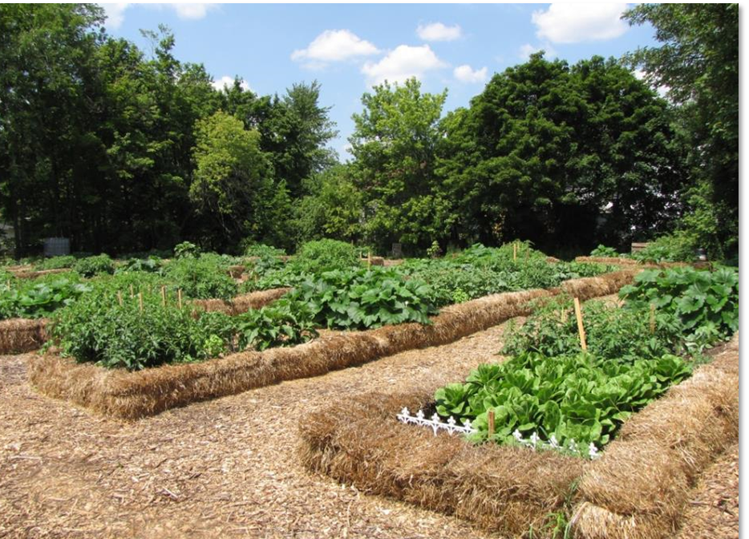
Contaminant Exposure Pathways
Objective: Reduce exposure!
Cover the soil
  Mulch
  Plantings
Constructed raised beds
Notes:
How can we reduce the risk of exposure to contaminated or potentially contaminated soils.
Keeping the soil covered is considered a very effective method. Covering bare soil is considered a basic best management practice at these sites. Many urban gardens will mulch pathways and bare soil with wood chips, such as in the photo. Establishing perennial plantings can also be effective for covering and holding soil.
Similarly, growing in constructed raised beds with imported soil material, or materials such as potting soil and compost, allows people to garden at sites with risk without coming into direct contact with the soil at the site. Many constructed raised beds utilize a barrier, such as landscape fabric, to separate the growing media from the soil at the site.
Photo: Youngstown Neighborhood Development Corporation. A community garden in Youngstown OH uses constructed raised beds and heavy mulching of pathways and open areas to reduce direct exposure to the soil.
Note: the raised beds in this photo are not consistent with the NRCS interim practice standard for Raised Beds, but are a good example of the concepts described in this slide.

Slide 10
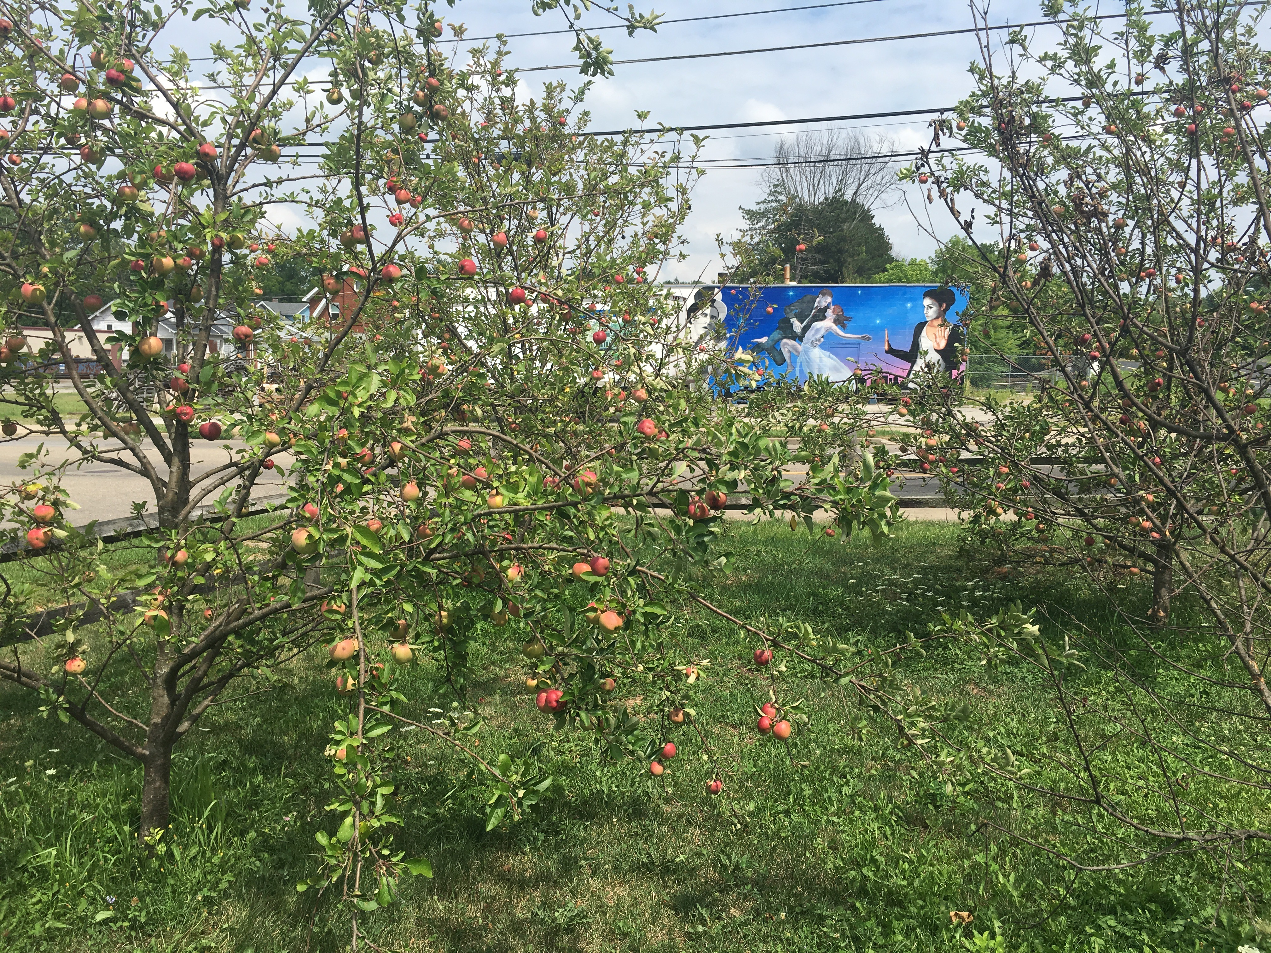
Contamination risk and crop types
What types of crops are suitable on sites with soil contamination risk?
Most Suitable
  Tree Fruits
  Fruit and Seed producing Vegetables
  Berries
Least Suitable
  Leafy Green Vegetables
  Root Crops
Notes:
Can open this slide with question – What types of crops pose the lowest levels of risk for the uptake and transfer of contaminants from soil ?
Fruiting crops – Research has demonstrated that plants do not transfer heavy metals into fruits in concentrations harmful to humans.
The risk of ingesting contaminants from crops grown in contaminated soil is higher for leafy green vegetables and root crops, where a portion of the growing body of the plant is consumed. Those crop types are generally also considered a higher risk for direct ingestion of soil, from both direct contact with the ground as well as splashing of soil onto the plant.
Source: “Soil contaminants and best practices for healthy gardens.” Cornell Waste Management Institute https://www.cwmi.css.cornell.edu/Soil_Contaminants.pdf
Photo: Josh Beniston, USDA NRCS. An apple tree and planting of fruit trees in an urban garde.

Slide 11
Question
Is lead contamination present at all urban sites?
Notes:
Ask group question and take a few responses.
This can be a tricky question. Research in urban soils has documented that many sites do not have elevated concentrations of contaminates, and that contamination according to EPA guidelines occurs in a minority of sites. However, other studies and anecdotal evidence also indicates that in some urban areas, the majority of sites do have elevated contaminates. Because of this, many organizations working on urban agriculture, including NRCS in at least a few states, operate with the presumption that urban sites do have lead contamination and implement preventative conservation practices such as raised beds and mulching at all sites.

Slide 12
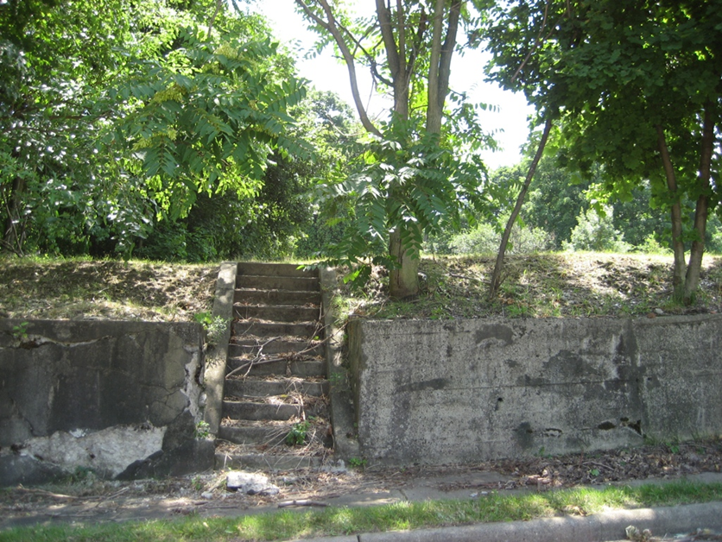
Importance of Site History
Management history of sites is a key factor in the condition of soils and presence of resource concerns.
Site history is also strongly connected with potential of soil contamination and associated risks.
Notes:
The history of sites is a major driver of the soil conditions in urban areas. Site history is also a major factor associated with the risk of soil contamination. There are a number of previous land uses that are considered red flags for the presence of contaminants in soils.
We will now look at some methods for learning about the history of sites and assessing the risk of soil contamination based on site history.
For planners, there are a number of tools that can aid in better understanding site history in the conservation process. For sites that show a high level of risk, NRCS also has CEMA 207 Site assessment and soil testing for contamination, which can provide financial assistance for bringing in technical experts from outside of NRCS to investigate site history and soil conditions.

Slide 13
Urban Soil Health Evaluation Process
Review background information on site conditions and history
Field assessment of site and soil conditions
Pre-screening of soil (when available)
Soil lab analysis
Data interpretation and management planning.
Notes:
The process outlined on this slide, as well as a lot of ofther information in this module, is taken from the NRCS Technical Note 470.03 Site Evaluation for Urban Soil Health. A number of NRCS staff, and collaborators, with significant experience working in urban soils collaborated on the information in the tech note.
The goal of this slide is to suggest a process for evaluating the potential contamination risk of soils at a site. Each of the stages in this process will be described more fully in this presentation.

Slide 14
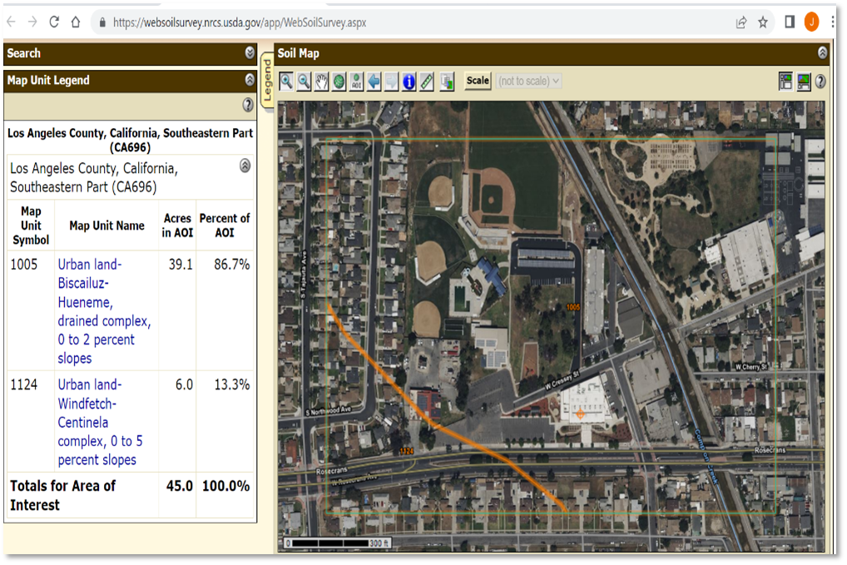
Online information sources
Web Soil Survey and SoilWeb
Google Earth historical imagery
Google search for address
EPA searchable database of known brownfield locations
Discussions with land managers/owners and community members
Notes:
A number of easily accessible online tools can be useful in learning more about the soil conditions and history of urban sites. Items on this list were all recommended by soil scientists and planners with experience in urban areas.
Web Soil Survey has information for urban areas, thought urban areas are considered to have less detailed and complete soil survey information. An increasing number of urban areas in the U.S. have modern soil surveys with more detailed information. Like rural areas, soil survey information is a starting place about soil conditions at a site and needs to be followed up with soil investigation in the field. This may be even more so in urban areas where an individual site may have a history of developmment that has completely altered the soil in comparison to the survey information.
Historical imagery on Google Earth can be very helpful in providing information about the land use history of a site in recent decades and many planners use this tool to look at the available imagery for sites. The caveat here is simply that those images generally only provide information about the past few decades of activity, while sites in many urban areas may have been in use for well over 100 years.
Some planners recommend a general Google search of addresses for urban sites to learn more about their history.
A very useful tool for investigating potential soil contamination is the US EPA searchable database of known brownfield locations. This database allows you to enter a zip code. The database then returns all addresses in that zip code where EPA has some record or documentation of a contamination issue. This can be helpful both for looking at the history of the site in question, as well as for identifying areas of higher risk in the surrounding neighborhood.
Finally, conversations with the land managers/owners and community members involved with the site can also provide valuable information about a sites history and any potential risks.
Photo: An area of interest in Compton CA, in the Los Angeles metro area. AOI includes a USDA partner People’s Garden site.
Planners can review available aerial imagery over several years to assess the historic use on or at the site.
Planners may interview the client regarding hazardous material potential.
Clients may visit with existing neighbors about past uses of the property.
Clients may have access to records or document such as a Phase I Environmental Site Assessment (ESA) report prepared by an environmental professional with relevant experience.
Some NRCS Soil Scientists have access to portable x-ray fluorescence spectrometry. This can be used to assess soil within a pit or probe tube for contaminates that might pose a risk of exposure to heavy metal contaminants.

Slide 15
Site Histories with Higher Risk
Type of Site | Lead (Pb) | Other Inorganic Contaminants | Organic Contaminants | Compaction | Topsoil Removed | Large quantities of debris
Near coal-fired power plant |  | X
Highway corridor or Heavily trafficked road | X | X
House / building demolition site | X | X |  | X | X | X
Industrial site | X | X | X | X | X | X
Parking lot | X | X |  | X | X | X
Farmland |  | X | X | X
Storage lot | X | X | X | X | X | X
Vacant urban lot | X | X |  |  |  | X
Notes:
These are a handful of specific land use histories that result in elevated risk for soil contamination and soil health resource concerns. This list is not comprehensive.
Some key items of note. Sites near heavily trafficked roads that have been in place since at least the mid 20th century may have significant risk for lead contamination from deposition of leaded gasoline exhaust.
Sites with a history of house and building demolitions may not be immediately obvious. This is a scenario where looking at historical imagery can be helpful.
One major land use of concern that is not included on this list is buildings and houses that were constructed before 1980 and may have had lead based paint on them. The area around the driplines of these buildings often has elevated lead levels.

Slide 16
Key Questions on Site History
Does the site have a history of industrial land uses?
Are there buildings or houses built prior to 1980 on, or adjacent to, the site that may contain lead-based paint?
Was there a building on the site previously that was demolished?
Is the site directly adjacent to a road where salts or other chemicals are applied? Or is it directly adjacent to a road that has been in place prior to 1980, when leaded gasoline was used?
Notes:
This is a list of key questions to ask during a site evaluation, as well as during client interviews, when assessing sites for potential risk of contaminants.
Questions 2, 3, and 4 on this list are primarily referencing the potential for lead contamination.

Slide 17
Key Questions on Site History
Is there a facility nearby that could produce a negative impact to the site such as laundromat, garage or other industrial operations? What is the proximity of the site to these locations?
Based on the proximity of the site to industrial facilities, as well as the direction of prevalent winds, does there appear to be potential for the airborne deposition of contaminants?
If response to any of these is YES, then additional level of review and screening.
Notes:
These questions are a continuation from the previous slide.
The recommendation is that if the answer to any of the questions is yes, then additional research and on-site screening or testing is recommended,.
Additional screening or testing may also be helpful at sites that don’t generate a yes response to these questions. Our recommendation is that if there is a yes response, then it is due diligence to pursue additional screening of the site.

Slide 18
Field Observations: Hazardous Materials
Hazardous Materials Field Inspection Checklist
Hazardous Materials Landowner Interview
NRCS documents developed for inventory and assessment of sites for conservation easements.
Provide tool for documentation presence and risk from hazardous materials during site visits.
Notes:
NRCS has an official checklist that can be useful for assessing and documenting the risk of hazardous materials in the field. The Hazardous Materials Field Inspection Checklist provides observational prompts and a means for documenting risk from hazardous materials during field visits.
The Hazardous Materials Landowner Interview sheet provides interview questions for clients about their knowledge of the presence and history of hazardous materials at a site.
These documents were developed as part of the inventory and assessment process for conservation easements. They are not currently, easily available on e-directives or an NRCS website. Both documents are included in the supplementary materials for this training. The HAZMAT Field Inspection Checklist is also available at the partner website linked below.
https://s30428.pcdn.co/wp-content/uploads/sites/2/2021/01/Hazardous-Materials-Field-Inspection-Checklist.pdf

Slide 19
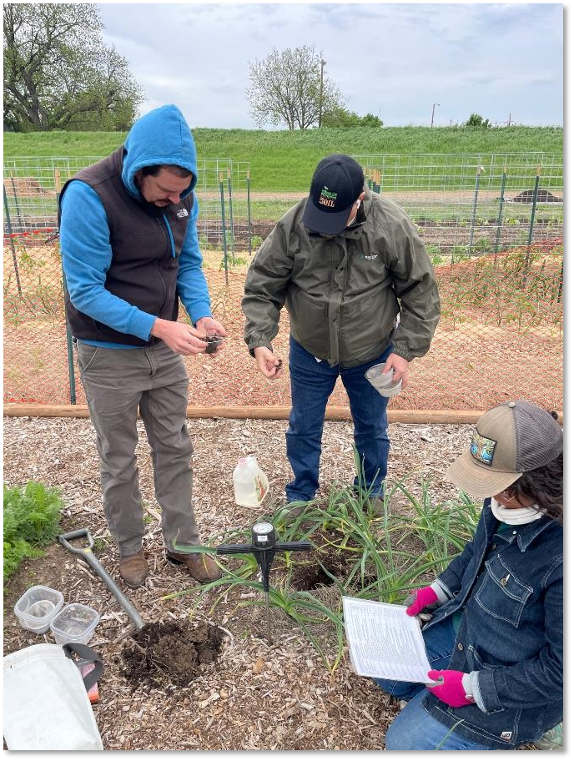
Field Observation of Soil Properties
Field observation on site history.
Observe key soil properties
  Raised beds? Soilless media?
  Is topsoil present or removed?
  Large quantities of coarse fragments?
  Flooding, seasonal water, or erosion?
  Surface texture class?
  More native soil type or highly altered?
Conduct IFSHA - if mineral soil at site is being used
Notes:
Field observation of soil properties is another key tool for site assessment. Direct observation in the field is not a method for assessing soil contamination, but is effective for assessing soil health resource concerns, and provides information on other soil concerns, as well as about the general picture of soil conditions on a site.
Some key questions that come into play for urban and near urban sites include those on this list, such as whether crops are being grown “in the ground” or in some type of raised bed or soilless media, as well as if the site has a topsoil layer.
At urban and small farm sites where crops are being grown in the ground/native soil, the Cropland In Field Soil Health Assessment is a robust tool for assessing and documenting soil health. IFSHA can provide an excellent opportunity for discussion and education around soil health with small-scale and urban producers. Cropland IFSHA does not match up very well with assessment of “soil health” resource concerns in constructed raised beds or soilless media, as those materials do not behave exactly like mineral soils. Also, IFSHA may not work as expected in mineral soils that are highly amended, usually from repeated heavy compost applications, on small-scale farms. Assessment of the health of soilless media and assessment of highly amended soils are areas that need additional work and instruction.
**Contaminant exposure is by inhalation and ingestion, so picking up soil barehanded is an exposure risk as hands go to faces frequently
Photo: Michael Higgins, USDA NRCS. NRCS Regional Soil Health Specialists conducting the Cropland IFSHA at an urban farm in Fort Worth, TX. The garden manager is looking through the IFSHA field sheet and discussing the soil management.

Slide 20
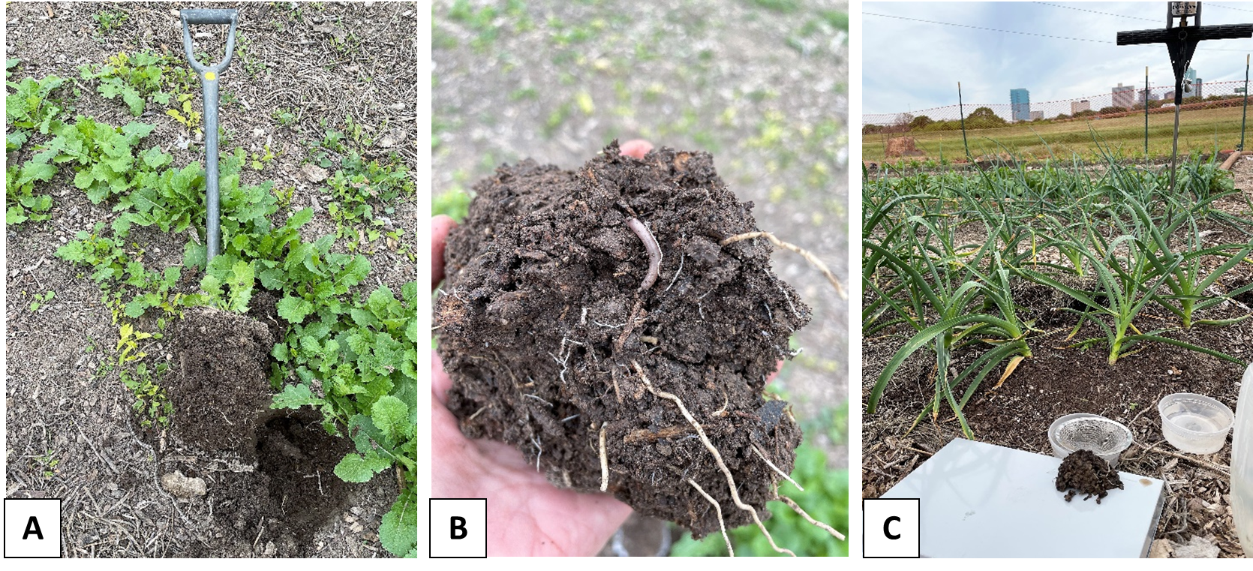
In-Field Soil Health Assessment (IFSHA)
To Identify Resource Concern Presence
Notes:
Many small-scale and urban farms practice good soil health management and have robust soil conditions. This is particular true of sites that amend their soils with organic matter, such as compost and mulch. IFSHA can provide good discussion and encouragement for soil health management at small-scale sites.
Photos: Josh Beniston, USDA NRCS. Photos of soil sampling, healthy soil clod, and assessment tools and methods for Cropland IFSHA at urban farm in Fort Worth TX, from preceding slide. Site displayed robust soil physical and biological health. The only resource concern observed at the site was compaction below 12in. Site had been managed with yearly applications of compost and mulch, as well as cool season cover cropping, for several years.

Slide 21
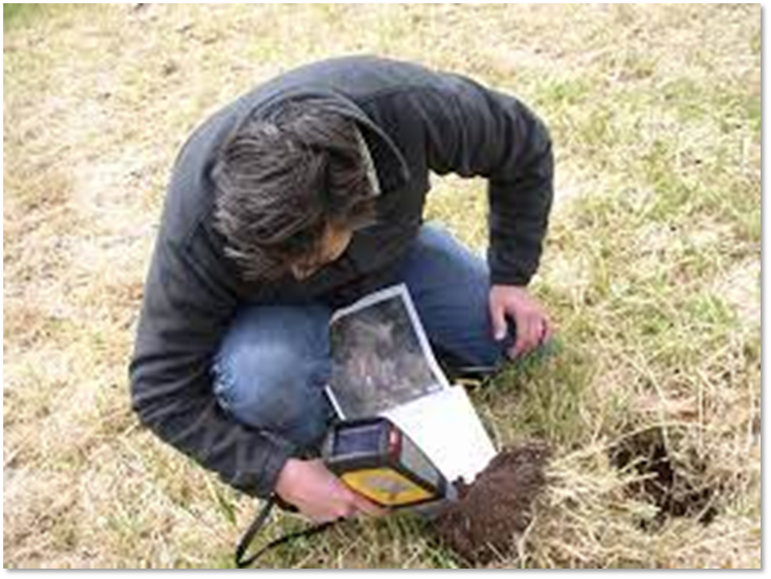
Pre-Screening of Soil with pXRF
Portable X-Ray Flourescence (pXRF)
Analytical instrument used for field or laboratory measurement of elemental composition of soil – including heavy metals.
  Accepted method for identifying resource concern.
Research shows agreement of heavy metal results with traditional lab analyses.
(Photo NJ NRCS)
Notes:
An increasingly prominent tool and method for determining the heavy metal content of soils is portable X-ray Flourescence (pXRF). XRF is an analytical instrument that measures the concentrations of more than 20 elements in soil samples (including key heavy metals). pXRF instruments can be used to measure soils in the field or in a benchtop setting.
XRF results are considered accurate, but not as accurate as the traditional laboratory methods for analyzing heavy metails. Research has shown that XRF results generally have a strong correlation with lab analyses. XRF results can be improved by some processing of the samples and doing the measurements in a controlled setting.
Because XRF is not always as accurate as traditional lab analyses, it is referred to as “soil screening” rather than “soil testing”. Soil screening with pXRF is generally considered accurate enough to determine of concentrations of lead in the soil exceed residential screening levels. When soil lead is observed by pXRF screening to be above screening levels, a few next steps are possible. (1) That evidence can suggest to the site managers that they implement conservation practices to cover the soil and reduce exposure. (2) Laboratory soil testing may be advised to better determine the specific concentrations of lead that are present. (3) Planners and soil scientists will often provide the client with extension publications on managing lead contaminated soils, or connect them directly to professionals, such as extension staff or staff from other agencies, to seek further management advice.
Photo: courtesy of New Jersey NRCS. Edwin Muniz is the State Soil Scientist in NJ and has done extensive work screening urban sites for heavy metals using pXRF. He has also worked to educate others in NRCS about this method.

Slide 22
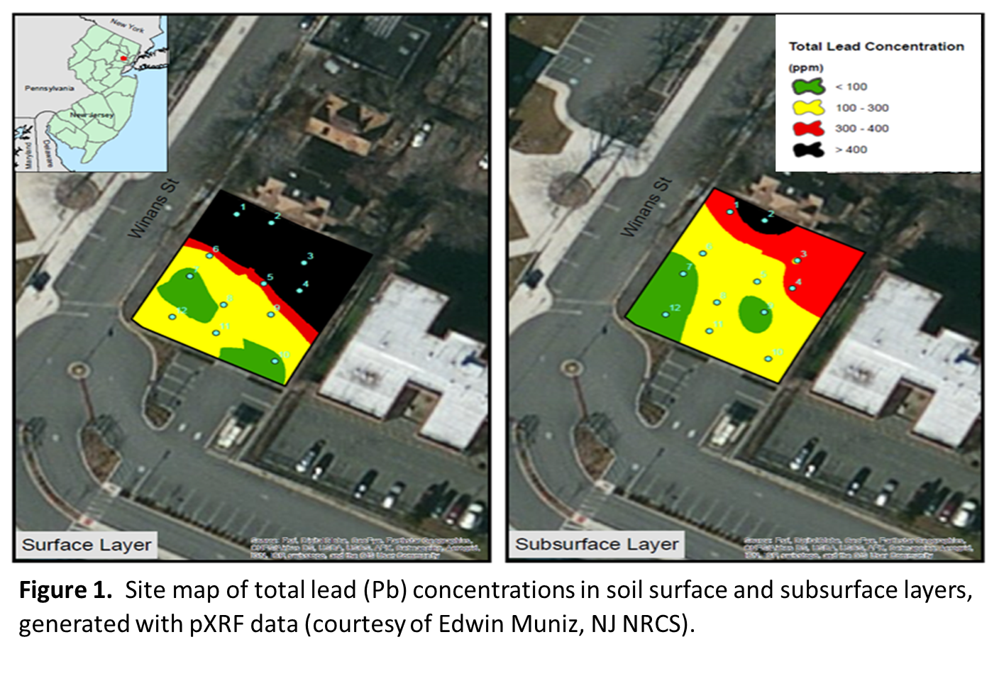
Site Map with pXRF Data
Notes:
An advantage of pXRF over traditional laboratory analyses is that the method can be used to screen many samples in a relatively short amount of time. Also, once the equipment is purchased, the cost of using the method is comparatively low compared with laboratory analysis.
The ability to screen a number of samples from one site allows soil scientists to map the concentration of elements of interest across sites, to create what some refer to as a “heat map.” This information is very valuable for site planning and management. Soil contamination is often highly variable across sites and occurs in hot spots. A site map like the one in the image allows a planner or land manager to plan for the appropriate conservation practices and soil management for different areas of the site.
Areas in black and red on the map have lead concentrations that exceed the USEPA residential screening levels.
Image courtesy of Edwin Muniz, USDA NRCS. Site map of total lead (Pb) concentrations in soil surface and subsurface layers, generated with pXRF data.

Slide 23
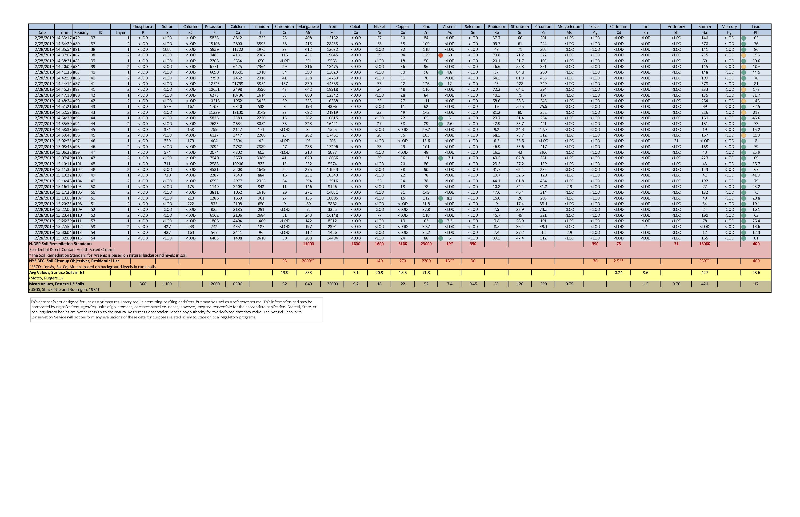
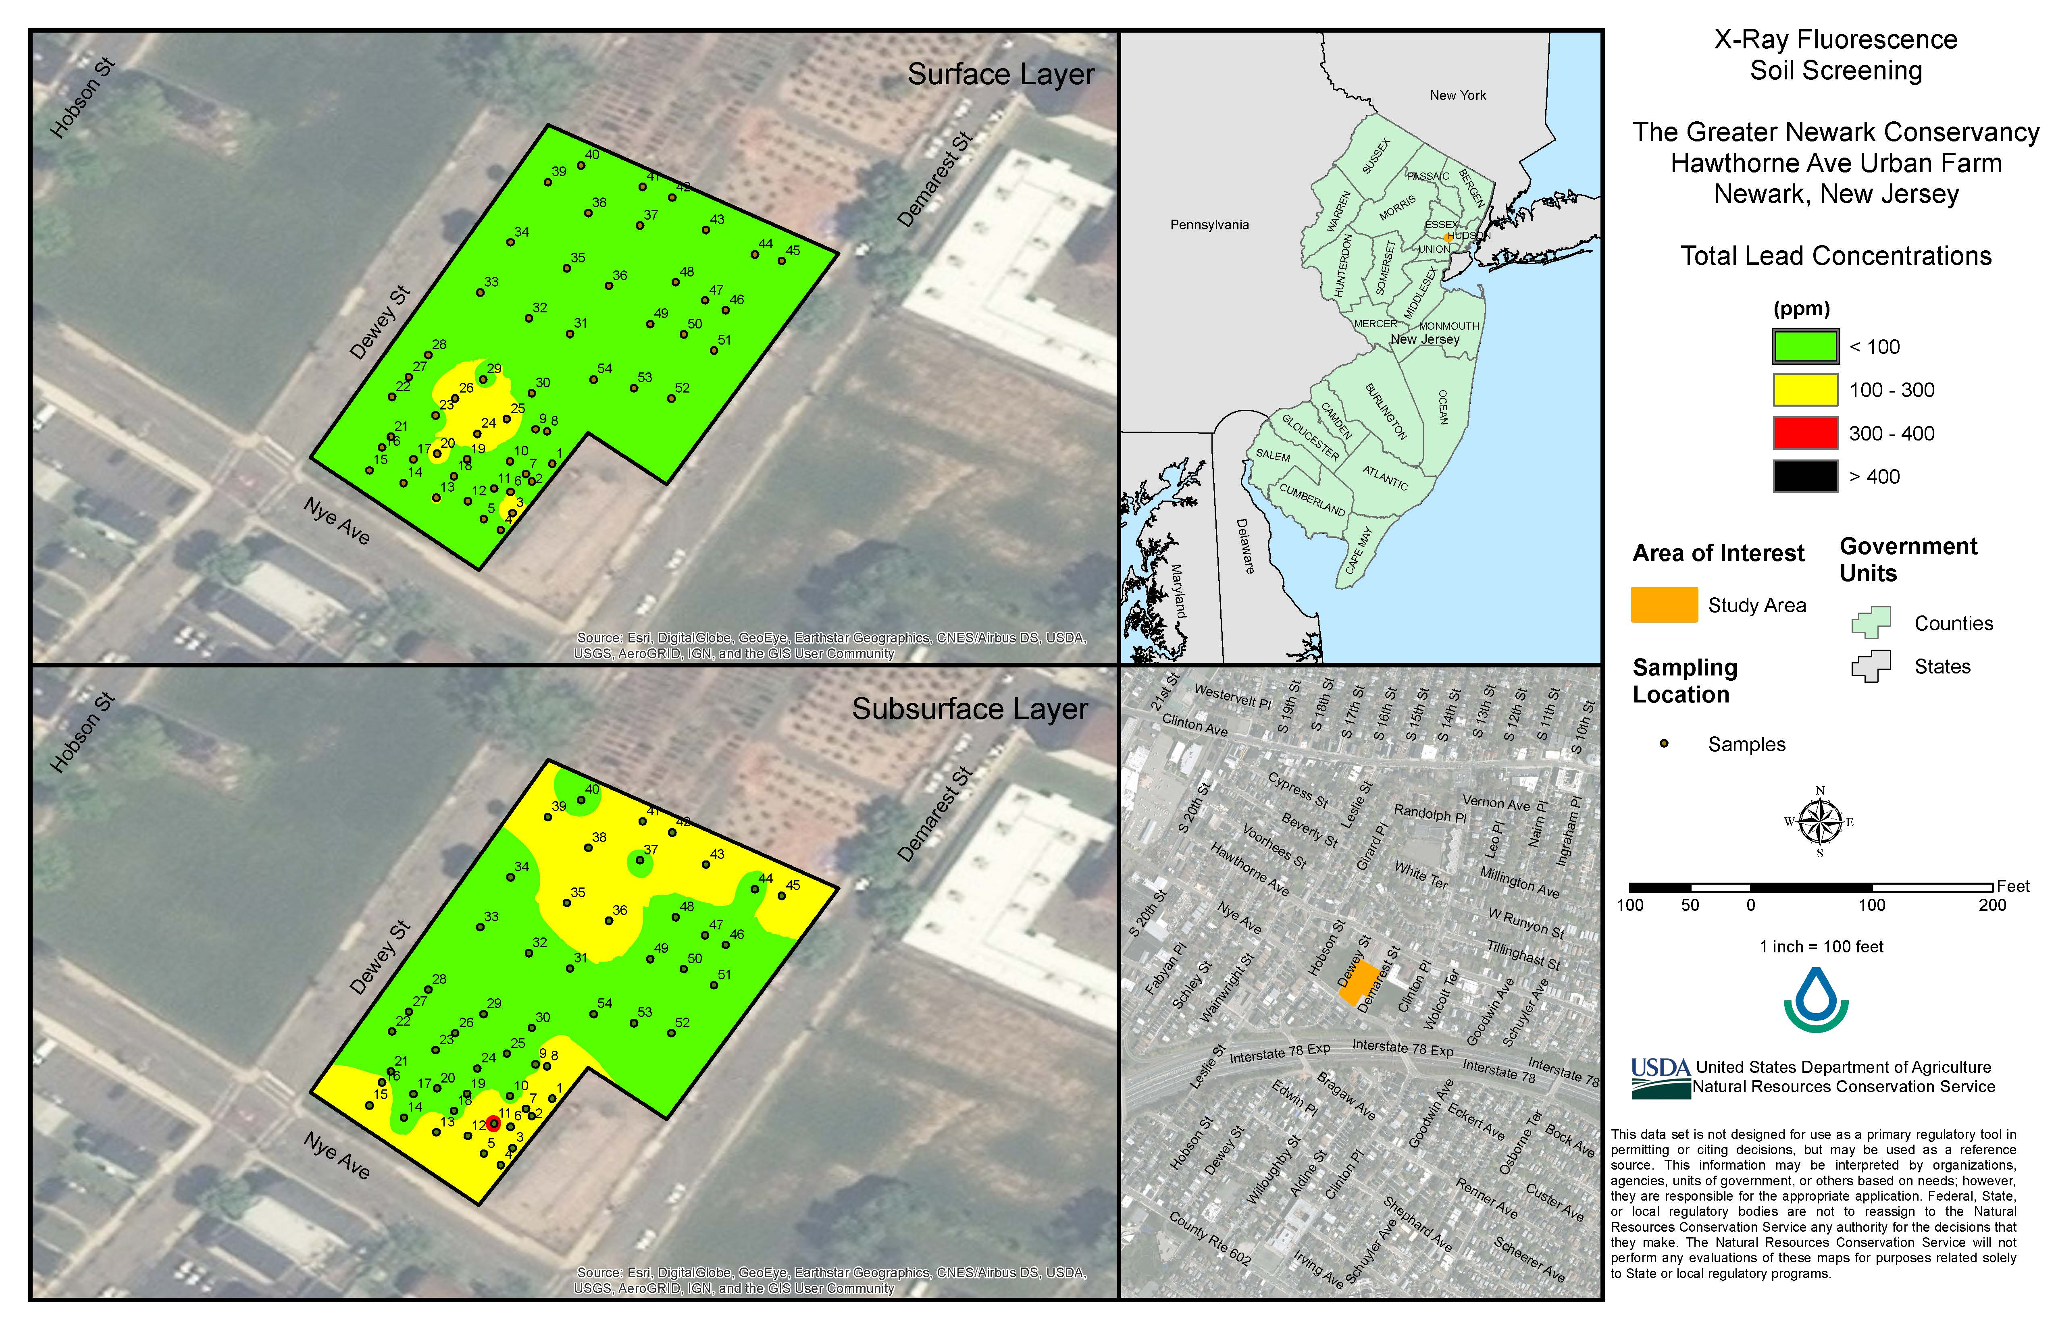
Results from pXRF soil screening
Notes:
This is one example of the type of information that can be generated for a site through pXRF screening. Depending on the data sharing policies of the state and region, this information can be provided to the client or conservation planners to assist in the best management of the site.
The spreadsheet contains the numeric values of the concentrations for all of the elements that have been analyzed. The image is a heat map, similar to the one on the previous page.
Images courtesy of USDA NRCS New Jersey.

Slide 24
Where is pXRF used in NRCS?
State Soil Scientists
Soil Scientists in Soil and Plant Science Division MLRA Offices
  TSS
Different approaches to data sharing and interpretation.
Notes:
Presently, the users and policies for pXRF vary in different states and regions of NRCS. In states where the tool is used regularly for conservation planning, the State Soil Scientist, or an Area Resource Soil Scientist, is generally the operator. There are also a number of soil survey MLRA offices across the country that have these tools. For those soil survey offices which are a part of the Soil and Plant Sciences Division (SPSD), a technical soil services agreement with the state is generally needed to involve those staff in conservation projects. SPSD scientists also use pXRF for analyzing the elemental concentrations as a part of their soil survey work.
There are also different policies regarding the sharing and interpretation of data from pXRF in these different areas of the agency.

Slide 25
Comparison on Soil Analysis Methods for Lead (Pb)
Method | Speed | Accuracy | Type
Home Soil Lead Test Kits | Quick | Wide Range | “Screening”
X-Ray Flourescence (XRF) | Quick | Moderate | “Screening”
Certified Laboratories | Slower | High | Laboratory “Testing”
Notes:
Comparison of methods for screening or testing soils for lead.
We have not discussed home soil lead tests, and they are not appropriate for use by NRCS. However, they are a tool that is available to the public and clients may have used them to screen their soil for lead. These tests vary widely and can not be relied on as a quantitative analysis. They are considered reliable for detecting the presence of lead, but are not as robust as either of the other two methods here.
XRF or pXRF is a fast and moderately accurate method for detecting the amount of lead in a soil. Analysis with XRF is not considered to be as accurate as laboratory testing. XRF analysis is referred to as screening in this context. XRF results are often used as the basis to make planning decisions in this area. When the resources are available, they can also be used as a first step that is followed by the more robust laboratory testing.
The most accurate form of analysis for lead in soils is to submit samples to a certified commercial laboratory or university laboratory for testing with laboratory analytical equipment. This is a slower process, and the cost is higher to the client, but the results have the highest level of accuracy.
Source: Soil Lead Screening: Understanding your results and next steps. NewYorkSoilHealth.org
https://bpb-us-e1.wpmucdn.com/blogs.cornell.edu/dist/6/7573/files/2024/12/NYSH-Lead-FactSheet_11152024.pdf
Mention home test kits

Slide 26
Conservation Evaluation and Monitoring Activity (CEMA) 207
Site assessment and soil testing for contamination
Purpose: An environmental assessment of the site and soil suitability for use in the cultivation of crops in urban and suburban areas.
Financial assistance to support client to bring in qualified individuals to conduct site history evaluation and soil testing
Notes:
For sites that have a history suggesting a high level of contamination risk, have screening results above EPA levels, or clients that want a very thorough site assessment and soil screening – NRCS has Conservation Evaluation and Management Activity (CEMA) 207 “Site assessment and soil testing for contamination.”
As the second bullet states, CEMA 207 provides financial assistance to bring in qualified individuals to conduct a site history evaluation, soil testing or both of those. Qualified individuals for this activity should have a professional background working on soil contamination and could include environmental consultants or extension staff focused on soil testing.
From CEMA 207:
1) Basic Site Assessment
a) QIs must have certification for conservation plan development and job approval authority as appropriate. QIs may include Technical Service Providers or State or Federal Agency Partners.
b) The site assessment activities include interviewing owners, operators and occupants; reviewing historical sources of information and federal, state, tribal and local government records; and performing visual site inspections.
NRCS planner can use: old aerial imagery if available, NAIP imagery past and current year, soil survey maps- "made land" implies significant disturbance or imported materials, client knowledge of the area's history.
Residental- potential for lead paint
Commercial- laundry, tool and die manufacturing, auto repair, chrome plating= chemicals we should not deal with
2) History of Site
The QI will conduct Environmental Site Assessments as described according to industry standards for identifying potential environmental concerns according to previous uses of the property.
ASTM-E1527: “Environmental Site Assessments: Phase I Environmental Site Assessment Process”.
The QI shall use Phase I Environmental Site Assessments (ASTM 1527) and All Appropriate Inquiry (40 CFR 312).
NRCS may use HAZARDOUS MATERIALS FIELD INSPECTION CHECKLIST from ACEP agreement documents

Slide 27
CEMA 207
Activities:
  Site Evaluation for Potential Contaminants – “Site history”
    (ASTM Environmental Site Assessment Phase I)
  Site Evaluation and Soil Testing for Contaminants
    (ASTM Environmental Site Assessment Phase I and 2)
  Soil Testing and Subsurface Investigation
    (ASTM Environmental Site Assessment Phase 2)
  Soil Testing for Contaminants on Low-Risk Sites
Notes:
There are four activities within CEMA 207. The site evaluation activity is an extensive evaluation of the sites history to identify potential risks of contamination. This includes database searches on the property, interviews, and on site assessment. The process follows the ASTM protocol, which is a national protocol utilized by many public agencies. This type of site evaluation is also often conducted in the process of putting properties into conservation easements.
The site evaluation and soil testing activity does the background investigation as well as an extensive on-site soil sampling and laboratory testing.
The third activity is the extensive soil sampling and testing activity.
The fourth activity provides financial assistance for laboratory soil testing at sites where either the background investigation, or a soil screening via pXRF, has concluded that contaminants may be present, and further testing is justified.
Activity
CEMA Section
Payment Scenario
Deliverable
Site evaluation for potential contaminants only
Basic Site Assessment and History of Site (a)
Site Evaluation for Potential Contaminants
Report detailing prior site use risk to contaminants. Statement of whether further investigation is needed.
Site evaluation and soil testing for contaminants
History of Site (a) and (b)
Site Evaluation and Soil Testing for Contaminants
Report with prior site use, probable source of contaminants, soil sampling map, soil analysis comparison to state safe use threshold
Soil testing subsurface investigation only
History of Site (b)
Soil Testing and Subsurface Investigation
Known contamination documented in prior EPA Phase I report or NRCS pXRF screening.
Soil sampling map, soil analysis comparison to state safe use threshold
Soil testing for contaminants on low risk sites
History of Site (b)
Soil Testing for Contaminants on Low Risk Sites
QI is owner/operator and soil sampling is to monitor atmospheric deposition of heavy metals on production areas.

Slide 28
CEMA 207 - Question
Who has used CEMA 207 or seen it used in your state?
Notes:
Ask the group if anyone has used CEMA 207 in their state? What was their experience? Have they looked into it?

Slide 29
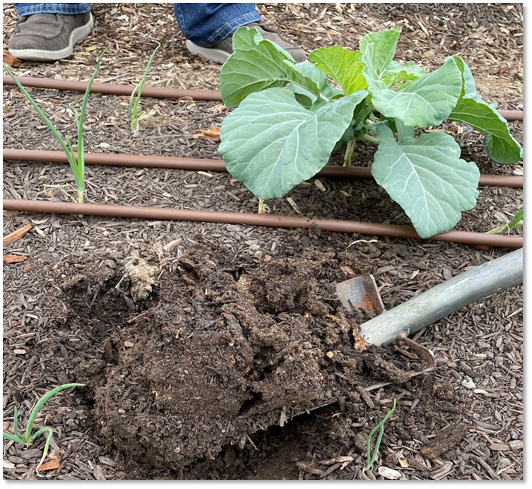
Soil Testing
Laboratory soil tests for urban agriculture fall under two broad objectives:
  (1) investigating the presence and concentration of heavy metals and other contaminants and
  (2) measuring soil properties that are important for agronomic management, such as nutrients and soil health indicators.
Generally, sites will benefit from conducting both types of soil testing.
Notes:
Go through bullet points on this slide. Urban agriculture projects can benefit from both soil testing for heavy metals, as well as soil testing for nutrients and/or soil health indicators.
Small farms of all types will likely benefit from doing soil testing for nutrients or soil health indicators. Soil nutrient testing tends to have a very good return on investment.
Photo: Josh Beniston, USDA NRCS

Slide 30
Soil Testing: Sampling Strategies
Composite samples to assess “average values” for sites
Areas with unique conditions and concerns (e.g., in the drip line of a building or areas close to a road), then it may need individual soil samples.
Larger, more complex sites with diverse conditions, collect representative samples from different areas with distinct
  Soil type or conditions
  Management of soil
  Crop type
  Land use history
Notes:
What kinds of soil sampling strategies should be used for small-scale and urban farms?
In general, composite soil samples, or collecting several small samples and mixing them into a composite sample. Composite samples can provide a reading on the “average values” of soil properties for a given site or management unit. Composites are recommended in the literature for basic assessments of contaminants and for soil nutrient testing.
In the case of soil contaminants, such as lead (Pb), it is also recommended to take individual soil samples from areas that may present a higher level of risk, such as in the drip lines of buildings that may have lead paint, or from areas that are close to busy roads. The logic is that if those areas do have elevated lead levels, we don’t want to dilute the sample by mixing it.
The third point here is that general guidelines for soil sampling are that in larger, or more complex sites with diverse conditions, we should divide individual sampling areas up so that samples are collected from areas that have consistent soil type, management, land use history, and general crop type on farms. Use composite sampling to collect a representative sample from each distinct sampling area.

Slide 31
Soil Testing:
Labs for heavy metal testing
Key Considerations:
Know what labs in your region offer testing for heavy metals and/or organic contaminants.
U.S. EPA guidance for land use is based on results specific lab methods.
Notes:
There are a few key considerations related to submitting soil samples to laboratories for contaminant or heavy metal testing.
The first is that many agricultural labs do not offer testing for heavy metals or organic contaminants. An important step for this kind of work is to identify the labs in your state or region where these kinds of analyses are available, and to then get an idea of the cost.
Second. US EPA’s guidance on soil screening levels and appropriate land uses are based on very specific laboratory methods that USEPA uses and recommends. Those methods are considered the standard. For heavy metals, some labs use methods that are different from the EPA methods. It is important to ask the lab if they are using EPA methods. If they are not, but they are the lba that you need to use for logistical reasons, it is very important to understand how their results relate to results generated with EPA methods. In general, USEPA methods are recommended for this kind of testing so that there are not questions about how the results relate to their recommendations.

Slide 32
Soil Screening Levels
Soil screening levels (SSLs) are based on calculations of risk from exposure.
U.S. EPA maintains public spreadsheet of SSLs for many contaminants at their Regional Screening Levels site.
Many U.S. states have their own screening levels and guidance for contaminants in soils – often Dept. of Environment.
Does your state environmental agency have guidance on soil screening levels for contaminants?
Notes:
For soil lead (Pb) results, there are recommendations for appropriate soil management for using sites as gardens. These recommendations are primarily from USEAP but are also produced by some states and university extensions. All of these recommendations are based upon soil screening levels. USEPA screening levels are considered the standard in many areas of the country. Many states, however, have state level environmental protection agencies that publish their own soil screening levels. Some state screening levels are different than USEPA and may be more conservative. So, it is important to know if your state has their own guidelines for screening levels of soil contaminants.
In states that have their own guidelines, the recommendation is for NRCS staff to work with that guidance. Determining whether or not your state has this kind of guidance is an important step in the process of working on soil contamination. In states without that information, the recommendation is to follow the USEPA guidance.
US EPA Regional Screening Levels - https://www.epa.gov/risk/regional-screening-levels-rsls-generic-tables

Slide 33
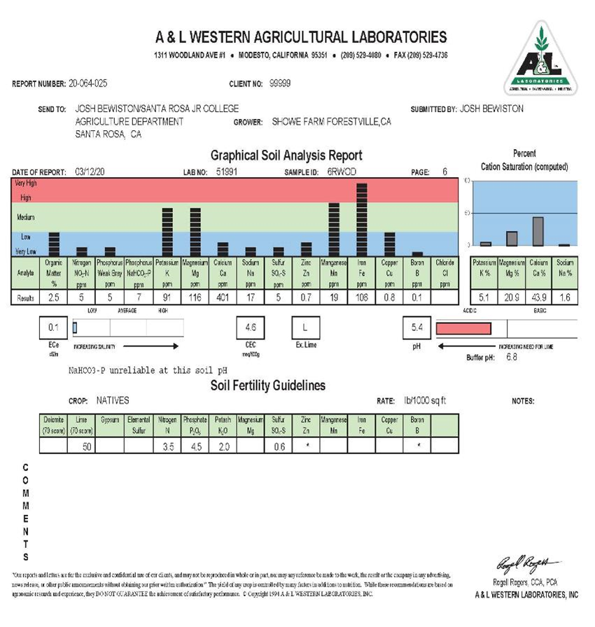
Soil Nutrient Tests
Good investment for small-scale farms and urban agriculture project.
Macronutrients can be low/limiting in urban soils.
Analyses recommended for urban agriculture (U.S. EPA 2011)
  pH
  Organic matter
  Macronutrients
  Micronutrients
  Heavy metals
Notes:
Soil nutrient tests are a good investment for any small-scale farm or urban agriculture project, particularly if they have not done soil testing before.
Research has demonstrated that macronutrient levels can be a limitation to plant health and productivity in some urban soils. This situation is easily corrected with amendments and nutrient management.
USEPA provided recommendations for soil testing for urban agriculture. They recommended that all urban agriculture projects have the soil properties listed above tested for their sites.
Image: One example of a soil nutrient test results print out. These results may be formatted differently by different labs. It is a good idea to become familiar with soil test results from a few different laboratories, so that you can interpret results regardless of format.

Slide 34
Additional Resources

Slide 35
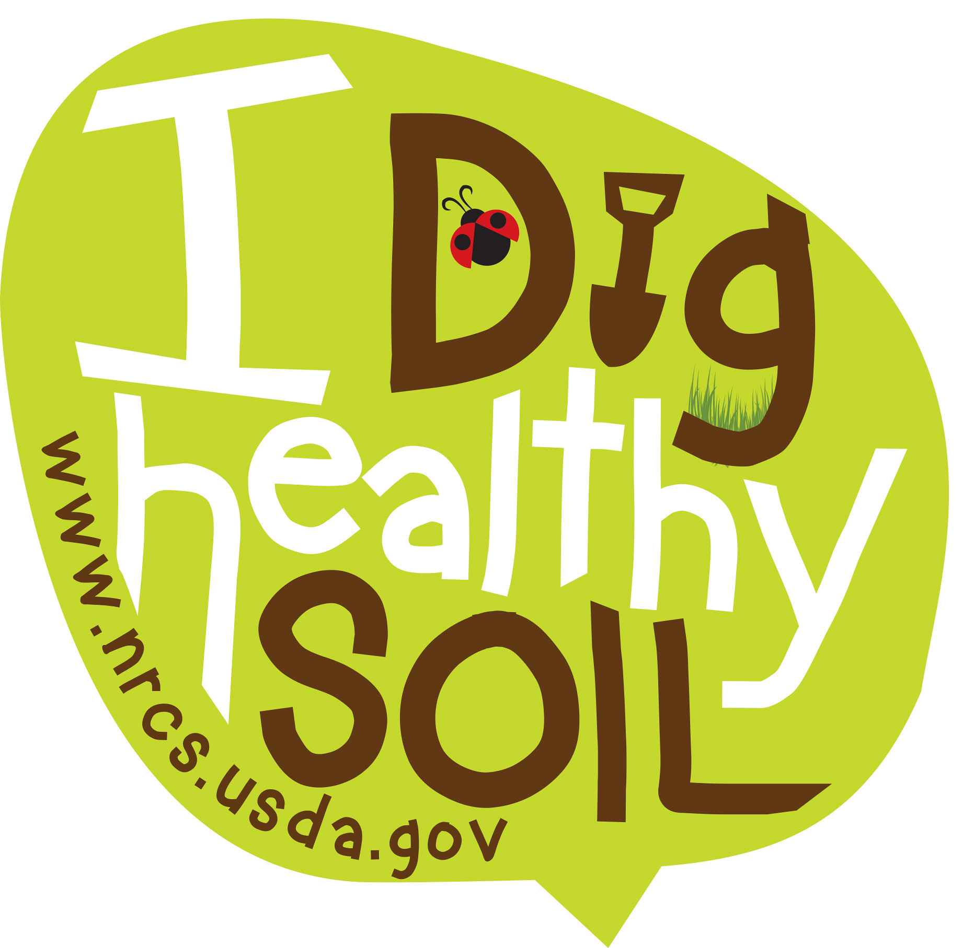
Questions ??

Slide 36

This information is provided as a public service and constitutes no endorsement by the United States Department of Agriculture or the Natural Resources Conservation Service of any service, supply, or equipment listed.
While an effort has been made to provide a complete and accurate listing of services, supplies, and equipment, omissions or other errors may occur and, therefore, other available sources of information should be consulted
The USDA is an equal opportunity provider and employer.
Meeh, NRCS

Slide 38
Background Info: US EPA Database

